Slide 1
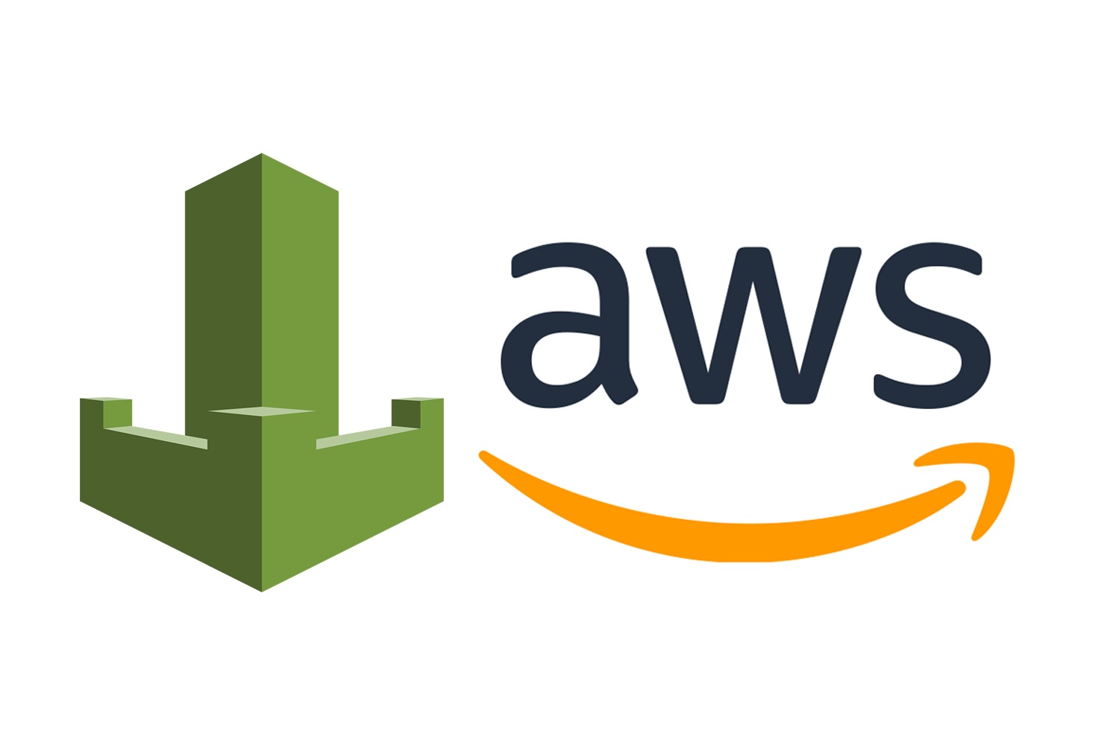
AWS WAF
Enhancing Security for Web Applications

Slide 2
Introduction to AWS WAF
AWS WAF is a cloud-based firewall service that helps protect web applications from attacks such as SQL injection and cross-site scripting. With its ability to analyze web traffic, AWS WAF enhances the security posture of applications deployed on AWS.
AWS Web Application Firewall (WAF) offers robust protection against common web exploits that may affect web applications. It allows users to create custom rules tailored to their applications’ security needs while ensuring compliance and security best practices.

Slide 3

Key Features of AWS WAF
AWS WAF provides features like customizable rules, real-time metrics, and automatic updates. Users can deploy the WAF across multiple AWS services, ensuring comprehensive protection, while benefiting from integrated security automation capabilities offered by AWS.

Slide 4
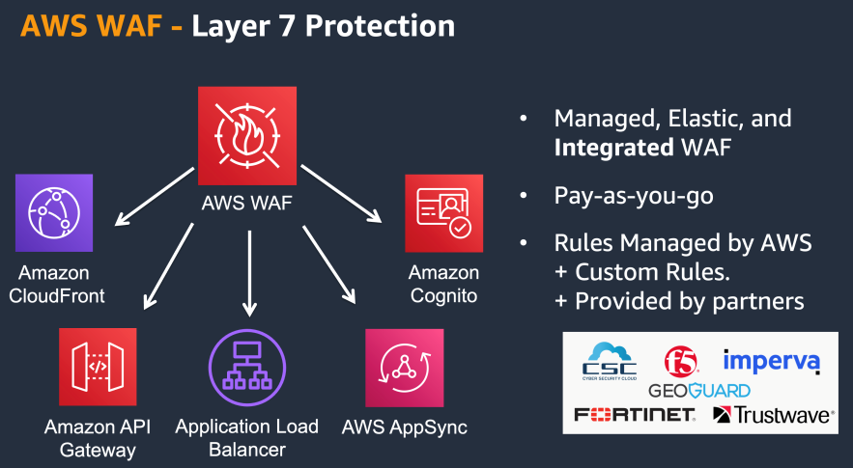
Use Cases for AWS WAF
AWS WAF is essential for safeguarding web applications in various scenarios, such as defending against DDoS attacks, protecting sensitive data, and complying with regulatory standards. Organizations leverage AWS WAF to ensure a secure online presence while enhancing user trust through robust security measures.

Slide 5
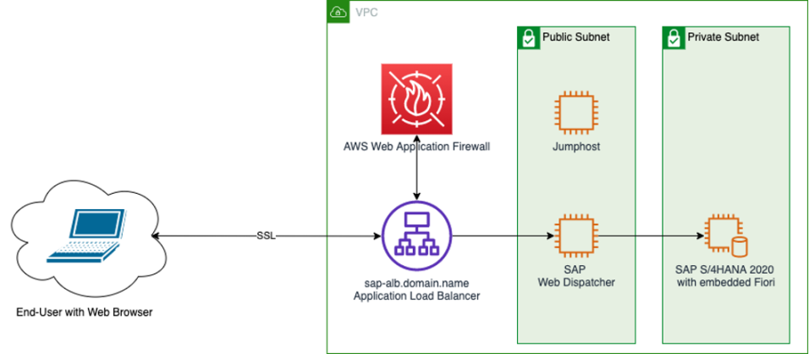
Setting Up AWS WAF
To set up AWS WAF, users must log into the AWS Management Console, create a web ACL, and attach it to their resources. This process involves defining the security policies needed to protect web applications while ensuring minimal disruption to normal operations.

Slide 6
Configuring Security Rules
Configuring security rules in AWS WAF allows organizations to specify which requests to allow or block. Users can create rules based on IP addresses, HTTP headers, or URI paths, thereby tailoring security measures to meet their unique application requirements effectively.

Slide 7

Monitoring and Logging in AWS WAF
AWS WAF provides comprehensive monitoring and logging features to track web traffic and potential threats. Users can leverage CloudWatch metrics and AWS logs to gain insights into traffic patterns and security incidents, ensuring timely responses to any emerging threats.

Slide 8

Conclusions
AWS WAF plays a pivotal role in cloud security, offering customization, scalability, and real-time monitoring capabilities. By implementing AWS WAF, organizations can significantly reduce the risk of security breaches and enhance their overall security frameworks. This ensures the protection of critical resources and customer trust throughout their online operations.

